Slide 1
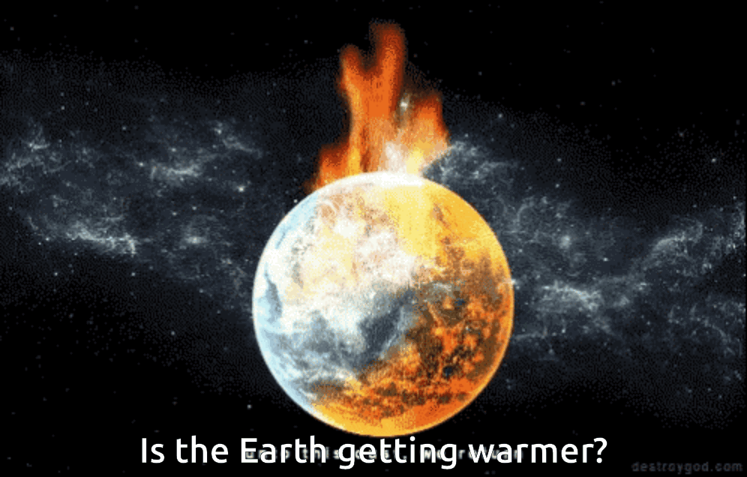




SIRIUS
POWERPOINT TEMPLATE
facebook.com
twitter.com
mail@mail.com
+81 12 3456 7890

Slide 2
THERMAL WARMING?
Who updates this : Albert
A STUDY OF GLOBAL TEMPERATURE, CO2 AND RADIATION
Describe the core message or hypothesis for your project.
Describe the questions you and your group found interesting, and what motivated you to answer them
Summarize where and how you found the data you used to answer these questions

Slide 3
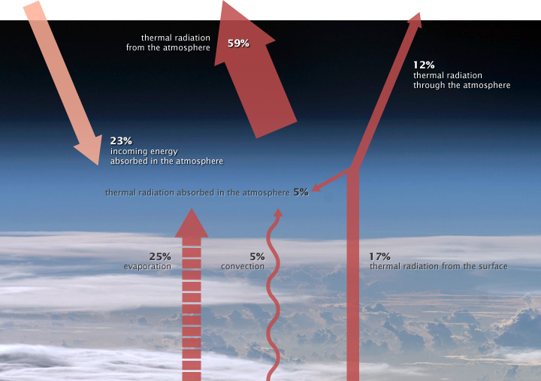
ILLUSTRATION OF THE ATMOSPHERE ENERGY BUDGET. PERCENTAGES VARY
(NASA illustration by Robert Simmon. Astronaut photograph ISS017-E-13859.)

Slide 4
Steps taken to achieve positive resolution:
Step A. Pre-Determining the basic assumptions in the Global Warming case:
Assumption 1: surface temperature is rising, and the global warming effect is present.
Assumption 2: distance decrease from Earth to the Sun produce a global warming.
Assumption 3: atmospheric Co2 trapping irradiating heat produce a global warming.
Assumption 4: atmospheric aerosol-mixed vapor particles produce a global warming.

Slide 5
Step B. Performing online research, setting measurement data parameters and ranges:
The Data Sets Primary data is set on 4 planetary measurements in units:
Surface Temperatures Levels in Degrees Celsius
Total Solar Irradiances (TSI) in Watts/m2
Atmospheric Co2 Gas Levels in parts-per-million(ppm)
Atmospheric Aerosols Particle Levels particulate matter—(pm/cm3)

Slide 6
Data Ranges:
Dates ranging from 01-01-1970 to 01-01-2019
Monthly Global Average Surface Temperature
Monthly Global Average Carbon (Co2) concentration in atmosphere
Monthly Global Average Total Solar Irradiance in atmosphere
Monthly Global Average Aerosols concentration in atmosphere

Slide 7
The project experienced issues obtaining pre-determined fully filled data set parameters, including:
Encountering unknown Data Range Variables
Locating Official Scientific Data Sources
Relating Available Scientific Measurements
Accepting Primary Scientific Data Collection Methods and Inconsistencies

Slide 8
Step C. Recognizing various relationship patterns and visualizing the output onto plots.
Locating the cause and effect relationship between:
Surface Temperature vs Time
Total Solar Irradiance vs Time
Atmospheric Aerosol vs Time
Atmospheric Co2 vs Time
Surface Temperature vs Atmospheric Co2 Gas Levels
Surface Temperature vs Total Solar Irradiance Levels
Surface Temperature vs Atmospheric Aerosols Particle Levels
Atmospheric Aerosol vs Atmospheric Co2 Gas Levels
Atmospheric Co2 Gas vs Total Solar Irradiance Levels
Atmospheric Aerosol vs Total Solar Irradiance Levels

Slide 9
Steps B and C will be covered in detail by the team members….(Then I will do the conclusion)
Final Analysis based on the collected data:
Assumption - Surface Air Temperature
Assumption - Atmospheric Total Solar Irradiance
Assumption - Atmospheric Carbon Dioxide Gas
Assumption - Atmospheric Aerosols Particles

Slide 10
ASSUMPTIOPNS
UOM
RADIATION
GHG
All values are at global levels measured in metrics(???). Currently we are getting data as
SOLAR RADIATION
Greenhouse Gases (GHG)
Temp in Centigrade
Solar Radiation in Watts/m2
CO2 and Air quality in metric tonnes / m2
Solar Radiation Comes as Total Solar Irradiance for NRL2 NASA project which takes care of uncertainties / measurement variations
Out of Greenhouse Gases (GHG), maximum contribution towards temp rise comes from CO2. So other GHG are ignored

Slide 11
HELLO,
LET ME INTRODUCE OUR GROUP…
Albert Gendelman
Guy Thompson
Madhuram Swaminathan
Steve
Wang
More information here if desired.

Slide 12





Steve – On Temp Extraction
Guy – On Temp Cleaning
Madhu – points on other Datasets
Describe the data exploration and cleanup process (accompanied by your Jupyter Notebook)
Handle Missing values and clean the data
Merging Data
Find Relationship between
Temp vs CO2
Temp vs Solar Radiation
CO2 vs Solar Radiation
Plot
Time-series representation of Temp rise
Impact of Solar Radiation on Temp
Impact of Co2 on Temp
Impact of both on Temp

Slide 13
Madhu
Describe the analysis process (accompanied by your Jupyter Notebook)
Describe the analysis process (accompanied by your Jupyter Notebook)
Merging Data
Find Relationship between
Temp vs CO2
Temp vs Solar Radiation
CO2 vs Solar Radiation
Plot
Time-series representation of Temp rise
Impact of Solar Radiation on Temp
Impact of Co2 on Temp
Impact of both on Temp

Slide 14
Conclusion
Solar
4
SOLAR IRRADIANCE
4
http://lasp.colorado.edu/lisird
d
Temp.
5
TEMPERATURE
5
ftp://ftp.ncdc.noaa.gov/pub/data/ghcn/v3
d
CO2
6
CO2
6
ftp://ftp.cmdl.noaa.gov/data/greenhouse_gases/co2/flask/surface
d

Slide 15
CITATIONS
Dlugokencky, E.J., P.M. Lang, J.W. Mund, A.M. Crotwell, M.J. Crotwell, and K.W. Thoning (2018), Atmospheric Carbon Dioxide Dry Air Mole Fractions from the NOAA ESRL Carbon Cycle Cooperative Global Air Sampling Network, 1968-2017, Version: 2018-07-31, Path: ftp://aftp.cmdl.noaa.gov/data/trace_gases/co2/flask/surface/.
CO2
J. H. Lawrimore, M. J. Menne, B. E. Gleason, C. N. Williams, D. B. Wuertz, R. S. Vose, and J. Rennie (2011), An overview of the Global Historical Climatology Network monthly mean temperature data set, version 3, J. Geophys. Res., 116, D19121, doi:10.1029/2011JD016187.
TEMPERATURE
This data comes from SORCE project sponsored by NASA – Satellite Program
SOLAR IRRADIANCE
Source 4 here.
CITATIONS
Source 5 here.
CITATIONS

Slide 16
THANK YOU!
ANY QUESTIONS?
Albert Gendelman
Guy Thompson
Madhuram Swaminathan
Steve Wang

